Slide 1
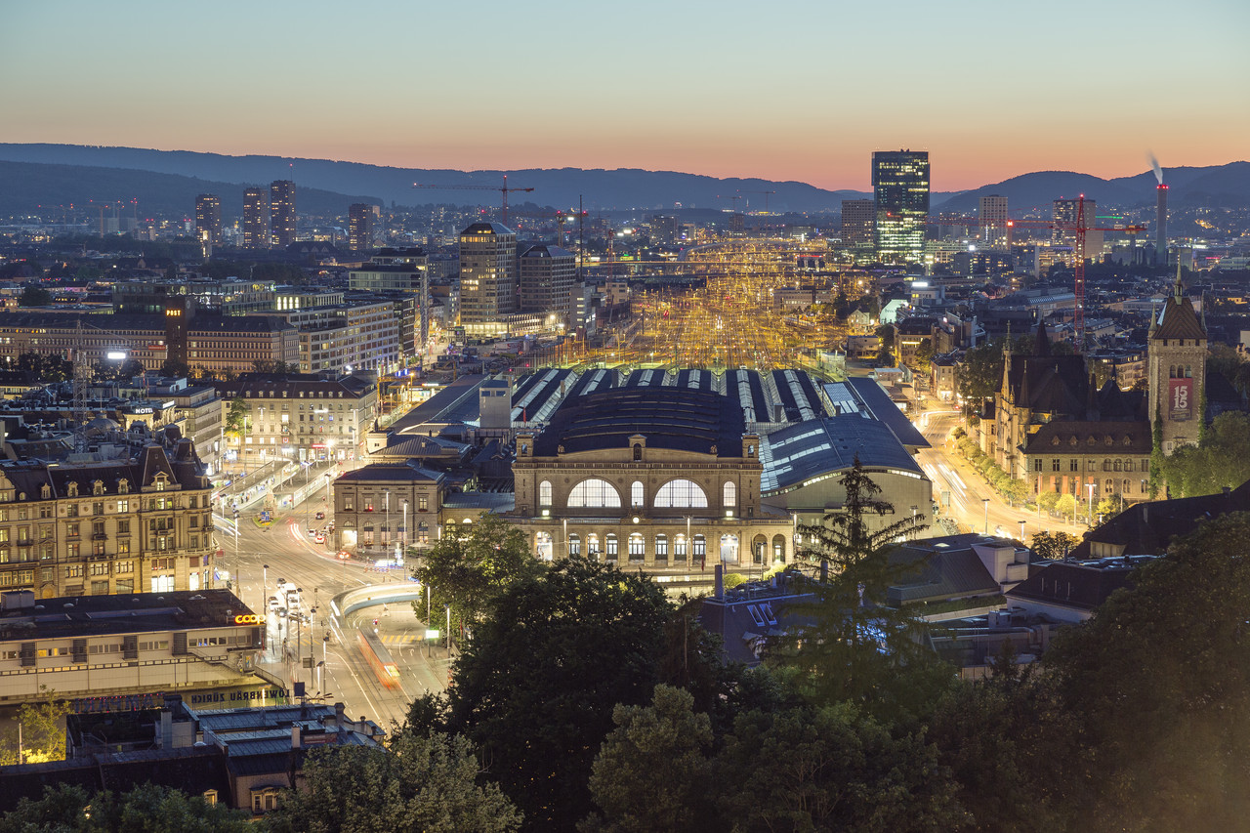
Group Assignment 10.1 - Value Proposition Roadmap
David Wenger, Fatima-Zahra Hamil, Benjamin Owusu Bediako

Slide 2
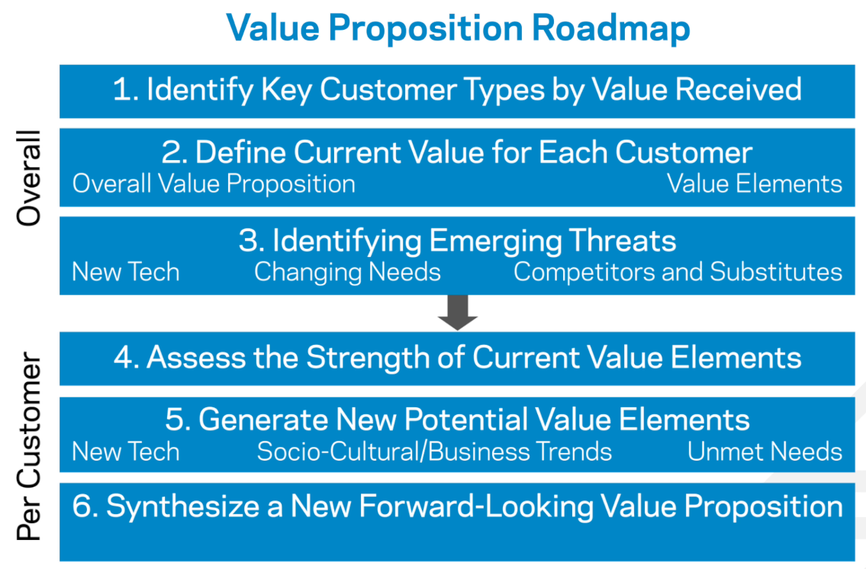
Reminder: Value Proposition Roadmap

Slide 3
Business in Focus: Zürich main station
Owned by Swiss Federal Railways SBB (sbb.ch)
450’000 travelers/day, more than 200 shops, 3000 trains/day
Biggest train station and biggest shopping mall in Switzerland
Business Model: Variable rents – the more turnover the shops make, the more rent they pay.

Slide 4
Step 1: Identify Key Customer Types by Value Received
Shops
(B2B customers)
Travelers
(B2C customers)
Local residents
(B2C customers)

Slide 5
Step 2: Define Current Value for Each Customer
Customer Type | Value elements (What benefits do they gain?) | Overall value proposition
Shops | High customer frequency Access to potential customers who need goods for their journey (e.g. food, drinks) Extended opening hours thanks to a special law (evening, weekends) | Optimal location for accessing travelers during the whole day including weekends.
Travelers | Utilization of waiting time with shopping Easy access to required goods Broad offer of goods (food, flowers, clothes, pharmacy, …) | Optimal utilization of waiting time through convenient shopping on their journey with few to no loss of time.
Local residents | Central location of the train station Extended opening hours thanks to a special law (evening, weekend) | Close-by shopping at any time.

Slide 6
Step 3: Identify Emerging Threats
Source | Examples
New technologies | Self driving cars might change the travel behavior of travelers, not passing the train station anymore Smartphones allow real-time price comparison Real time access to train schedules decreases the waiting time of travelers at the train station.
Changing customer needs | Remote work leads to less frequencies in the train station, because people don’t have to travel to work anymore Shops need more space to create a better experience Travelers change their food consumption behavior to healthier food Travelers order goods at home
New competitors | Rise of online shops New business models in retail (Click & Collect, …) Shops offering more “customer experience”

Slide 7
Step 4: Assess the Strength of Current Value Elements
Company: SBB (Zürich main station)
Customer type: Shops
Overall Value Proposition: Optimal location for accessing customers during the whole day including weekends.
Value element | Decreasing value to customer (shop)? | Increasing value to customer (shop)? | Overall verdict?
High customer frequency | Remote work and self-driving cars lead to less frequencies |  | Challenged
Access to travelers who need goods for their journey | Online-shops attack retail business |  | Challenged
Extended opening hours thanks to a special law |  | People work more each year, therefore more people want to do shopping in the extended hours. | Strong
Overall conclusion: For the customer segment of “Shops”, the strong value element are the extended opening hours. The threat to lose customers (less travelers remote work, online shops) challenges the value proposition of Zurich main station for this customer segment. Currently no disrupting elements can be identified.

Slide 8
Step 5: Generate New Potential Value Elements (Shops)
Source | Examples | Possible new value elements
New technologies | Big Data Real time monitoring Digital screens | Create digital services (e.g. dashboards of predicted frequencies, based on historical data) for shops to better plan their staff Digital screens can guide group of travellers to currently low-frequented shops to balance waiting times for travellers and to equalize turnovers of shops. Virtual store: Customers can scan their groceries on a screen in the train station and the order is delivered at home when you arrive home
Trends in customer environment | Expand customer experience in shops Click & collect models, customers can order online and collect in the store | Investing in customer experience elements (such as better heating in winter, live events, new architecture) in the train station to achieve together with the shops a better overall customer experience. Integrate click & collect features in the digital channels of the train station to offer an integrated click & collect service for the whole train station.
Unmet customer needs | Access to customer data and prevent loss of customer data to aggregators that could harm future innovations Robots to automate arduous tasks (logistics) Involve developers to create new business and service models | Building a platform including customer data to foster innovation by sharing, opening and connecting feedbacks that are based on customer experience, data, cybersecurity, freight 4.0, connectivity along the travel path and; Internet of Things (IoT) and maintenance 4.0. Build an automated logistic platform in the train station run by robots Creating an engaged developer community to help build digital service ecosystem so there could be an improvement of customer satisfaction, and also reduce churn.

Slide 9
Step 6: Synthesize a New Forward-Looking Value Proposition
Company: SBB (Zürich main station)
Customer type: Shops
Existing Overall Value Proposition: Optimal location for accessing travellers during the whole day including weekends.
Core elements - to build on | Weakened elements - to bolster | Disrupted elements - to deprioritize | New elements - to create
Law of extended opening hours | High customer frequency | none | Increased customer experience; acquire new types of shops (leisure, services)
Revised Value Proposition (for shops) | Optimal location for accessing travelers and local residents seven days a week till late in the evening through providing a superior customer experience in Zurich main station.
Specific areas of innovation | Customer experience, shopping experience, digital services, architecture

Slide 10
Vision
“Zurich main station shall transform to a place where people want to come, thanks to it’s comprehensive customer experience”
To increase the customer and shopping experience, new digital services for the shops, the travelers and the local residents shall be initiated. Additionally, the architecture shall be adapted, focusing on the various customer segments. This will result in a place where people want to go because of the superior experience, combined with innovative and convenient services.
Further Information:
About SBB Real Estate: www.sbb-realestate.ch
App: ”SBB My Station”

Slide 11
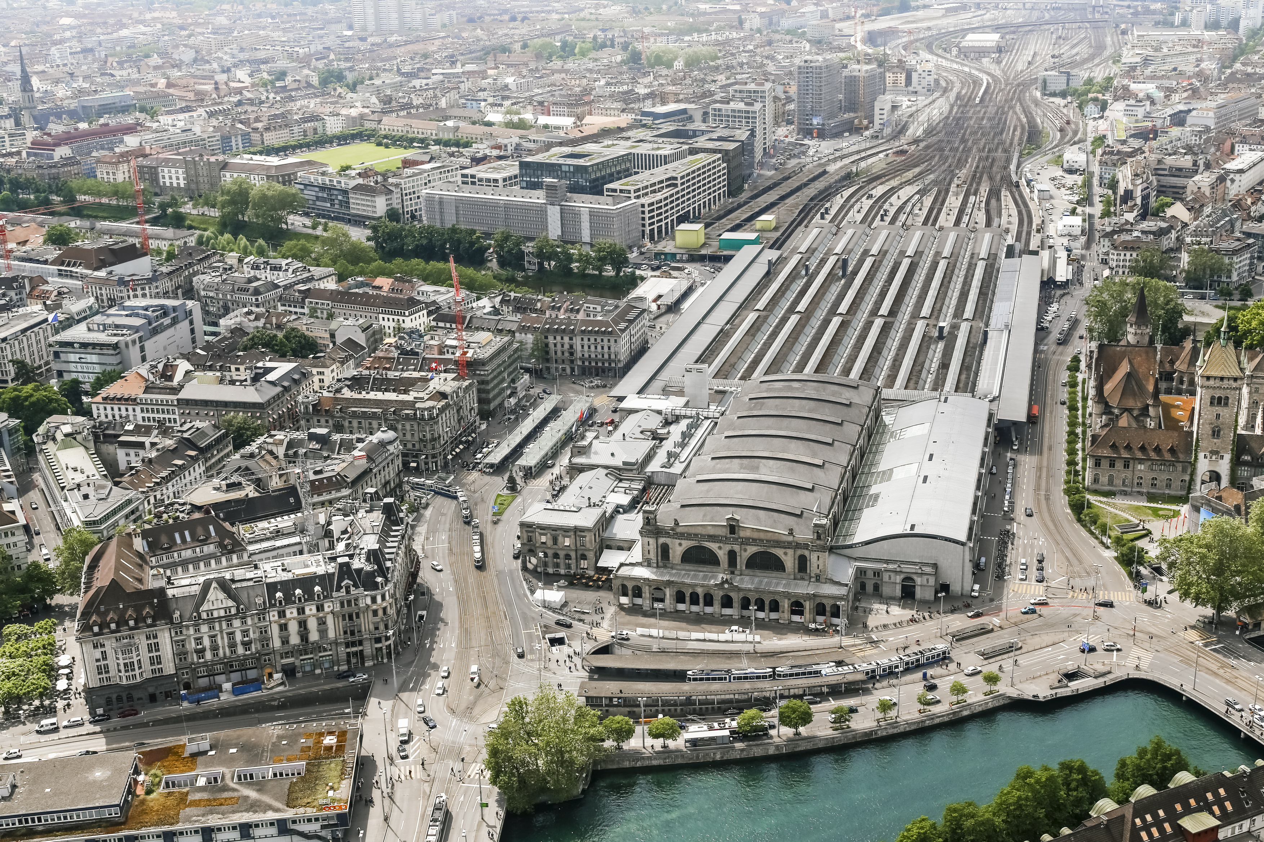
Thanks to the EMERITUS-Team & Students!
Let’s connect!
Fatima-Zahra Hamil
(fhamil@gmail.com),
Benjamin Owusu Bediako
(benaldros@gmail.com),
David Wenger
(davidwenger82@gmail.com)

Slide 12
Backup

Slide 13
Step 1: Identify Key Customer Types by Value Received
The business in focus is the train station “Zurich main station” in Switzerland, owned by Swiss Federal Railways SBB. With more than 450’000 travellers per day and more than 200 shops, it’s not only the biggest train station in Switzerland but as well the biggest shopping mall. The train station earns money through the variable rent of the shops. The more turnover the shops make, the more rent they pay.
Key Customer Types of Zurich main station (segment by value received)
Shops (B2B customers)
Travellers (B2C customers)
Local residents (B2C customers)

